Slide 1
Security Operations
Sonika Verma
CSCD92: Week 10

Slide 2
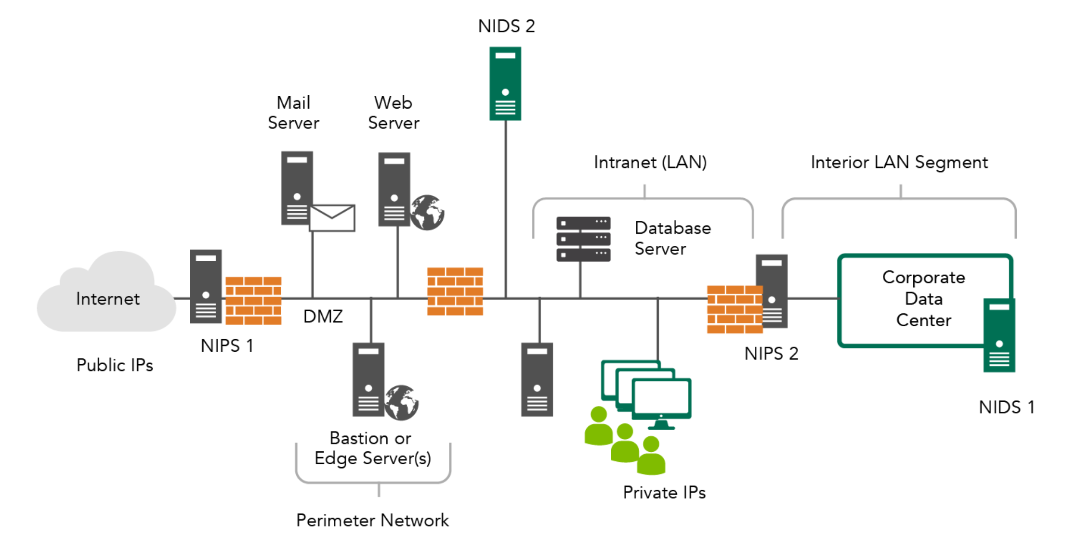
Logging and Monitoring Activities
Log management
Events
Precursors, indicators, indicators of compromise
Intrusion
Intrusion detection, intrusion prevention
Perimeter, host, network-based
Deviation, signature, pattern matching, heuristic
Logging limitations

Slide 3
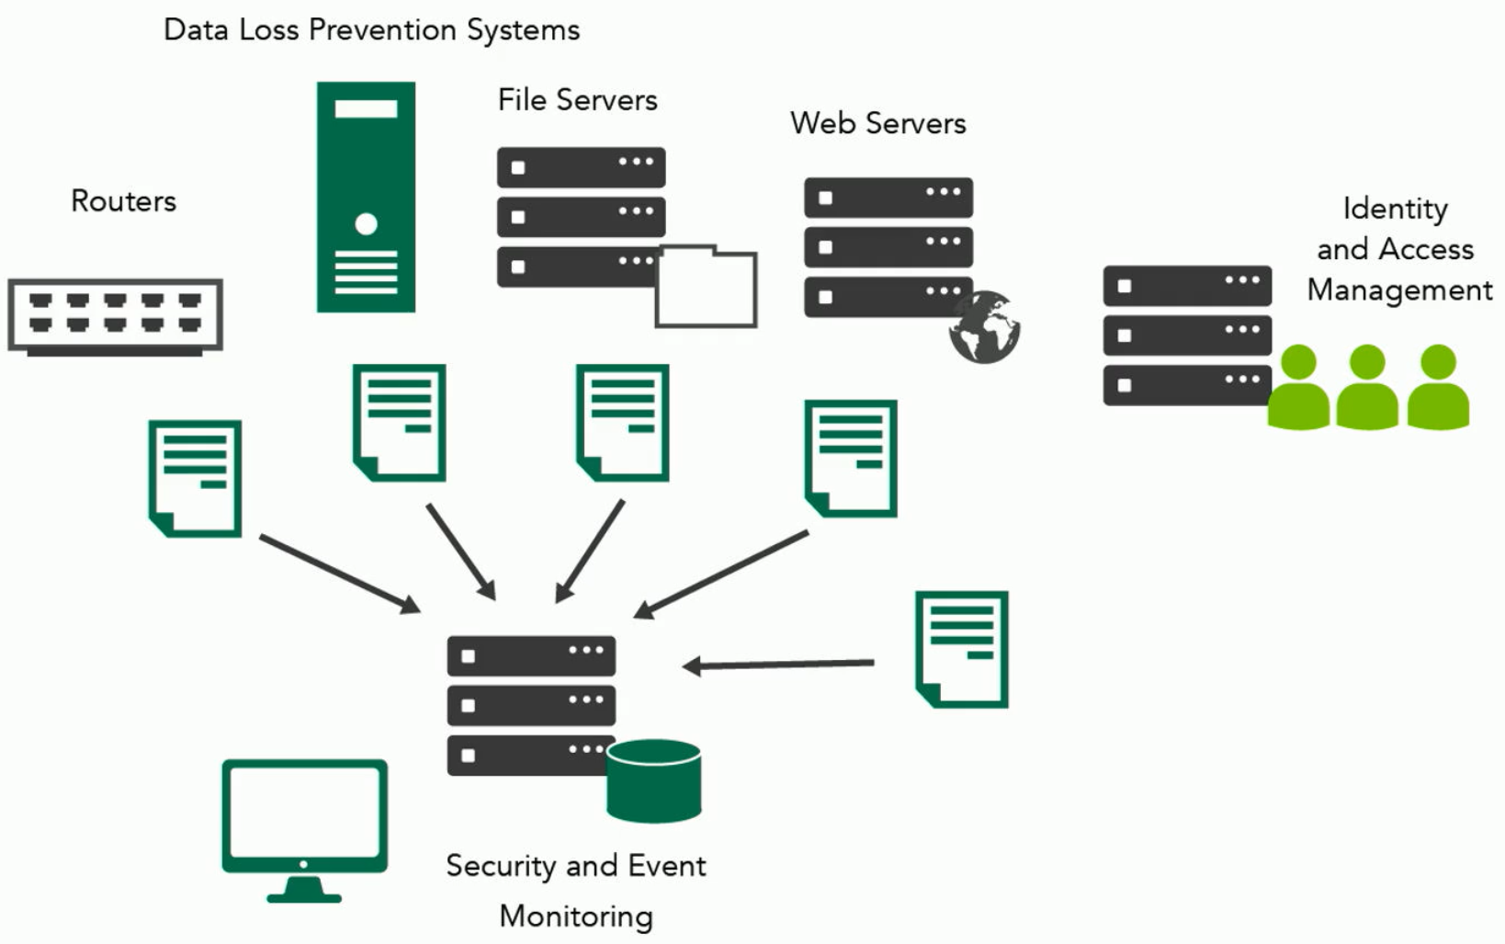
Logging and Monitoring Activities
Threat modelling
Threat intelligence
Internal, external
Security information and event management (SIEM) systems

Slide 4
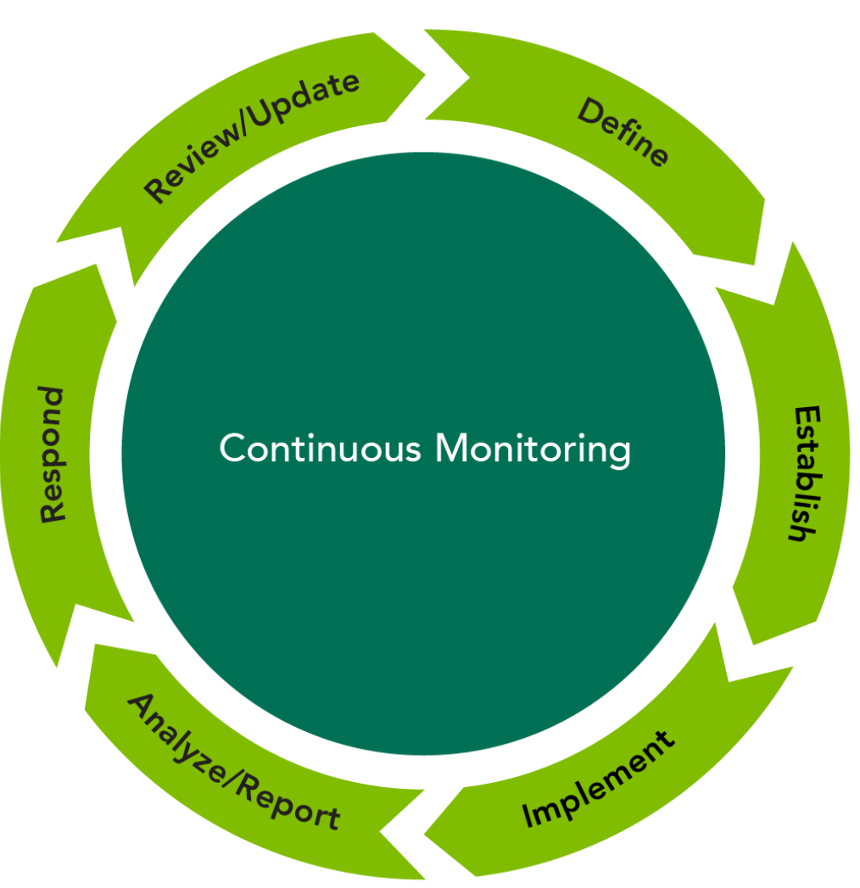
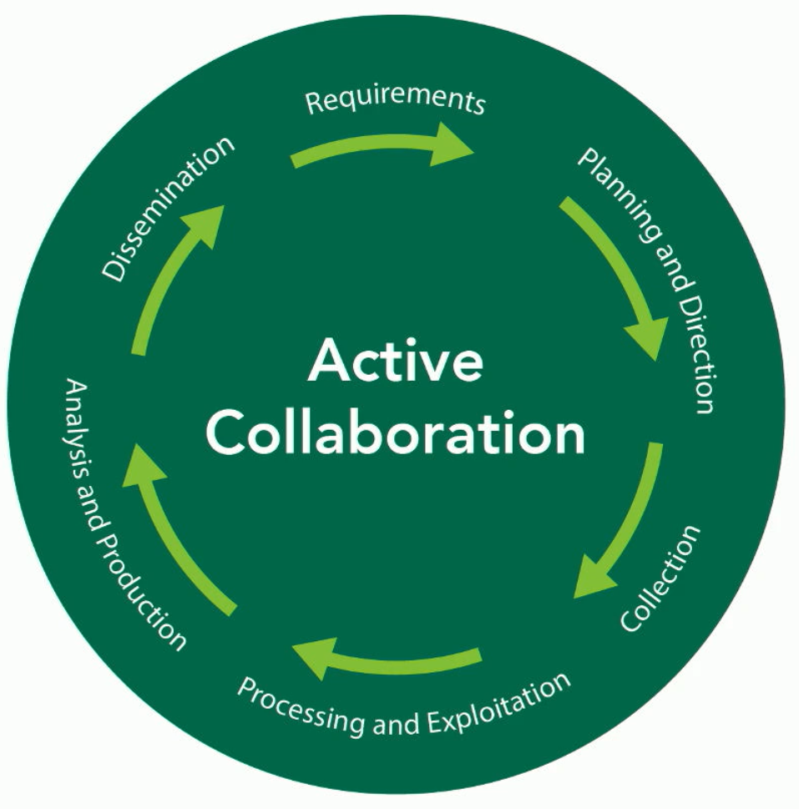
Continuous Monitoring
Information security continuous monitoring
Ingress, egress monitoring
User and behaviour entity analytics (UBEA)

Slide 5
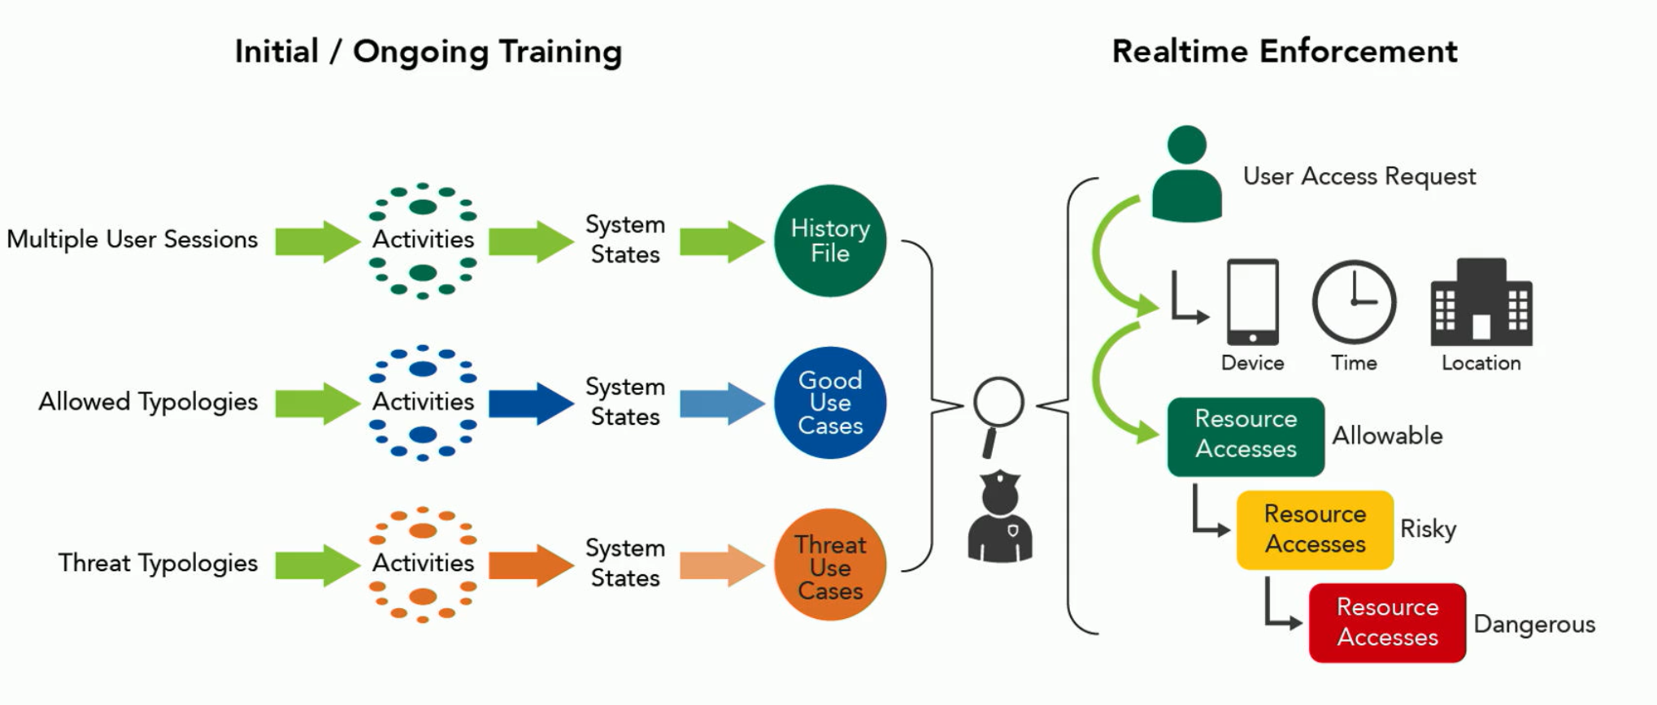
Change Management
Change management, change controls
Configuration item
Disruptions
Baselining
Enumerated, configuration, build or deployment, modification or update or patch, security baselines
Vulnerability management
Configuration automation

Slide 6
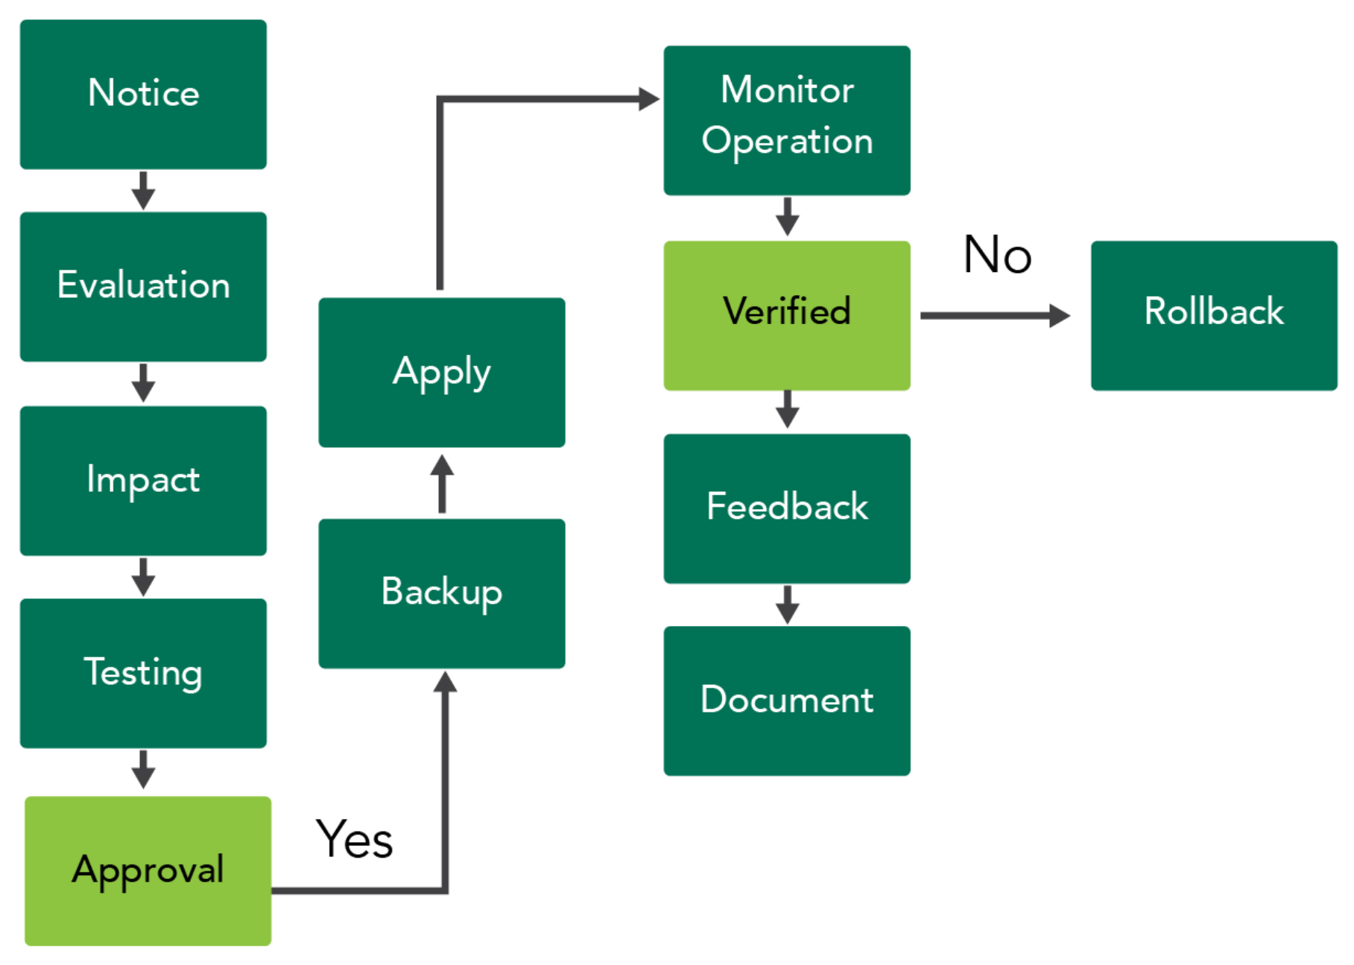
Change Management Activities
Change initiation
Request for Change (RFC)
Change review and approval
Implementation and change evaluation
Release, deployment planning, control
Patch management
Receive notice, determine applicability/urgency, determine potential impacts/risk, test, backups, apply patch, confirm installation, user feedback, rollback if warranted
Documentation

Slide 7
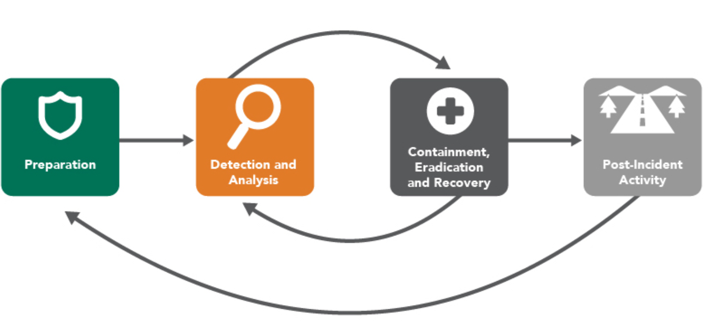
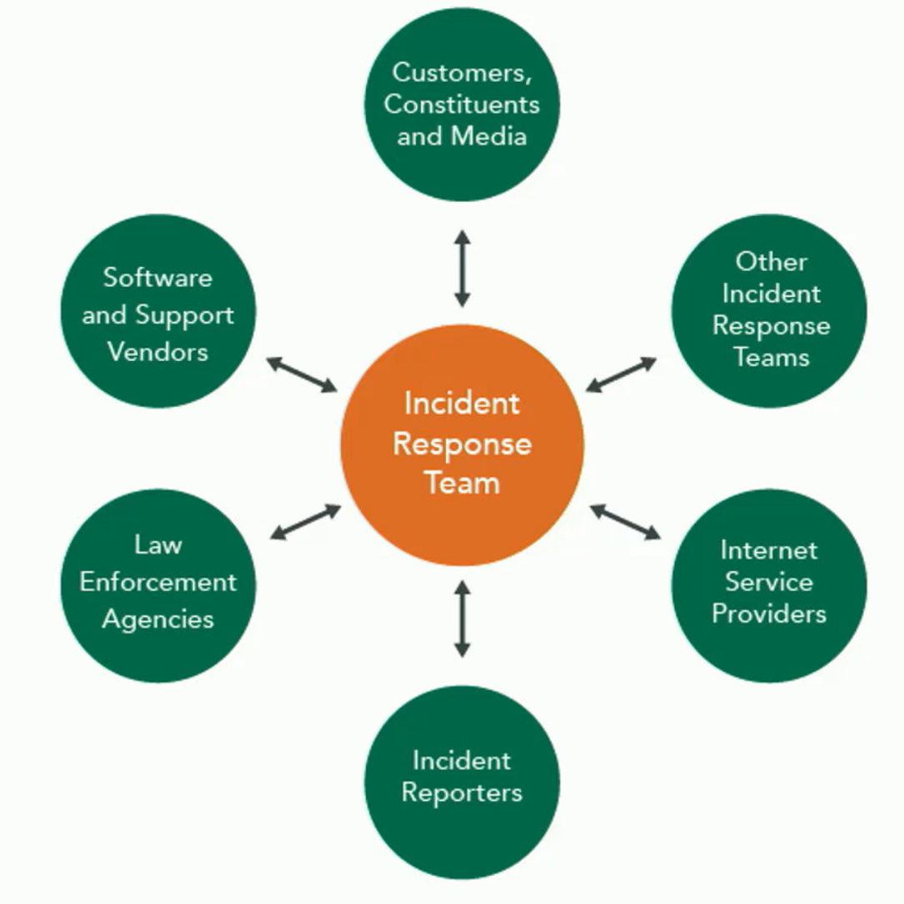
Incident Response
Incident
Incident response
Incident response plan
Incident response standards
Cyber forensics
Security Operations Center (SOC)
SIEM systems
Security orchestration, automation, and response

Slide 8
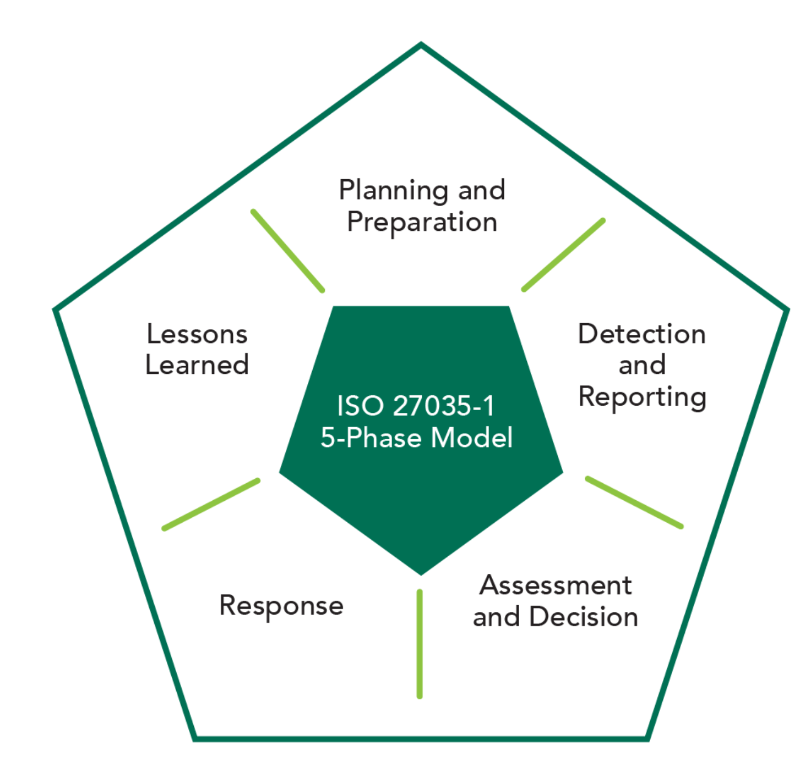
Incident Management
Preparation
Define policies, address incidents, communication, delegation of responsibilities, escalation and prioritization scales
Detection
Event documentation until resolution
Analysis
Event correlation, determining risk, event notification
Response
Root cause analysis
Mitigation
Containment, eradication
Recovery and remediation
Reporting
Review and improvement

Slide 9
Detective and Preventative Measures
Allowed/blocked lists
Firewalls
Sandboxing
Honeypots/honeynets
hackback
Anti-malware defenses
Software defined security
provisioning

Slide 10
Backup and Recovery Strategies
Minimum protection
3-2-1 rule
Backup locations
Onsite, offsite, cloud
Backup types
Full, differential, incremental
Journaling, snapshot
Backup considerations
Alternate sites
Mirror site
Hot sites, warm sites, cold sites
Mobile sites
Cloud
Relocation kits
Multiple processing sites
Centralized data storage

Slide 11
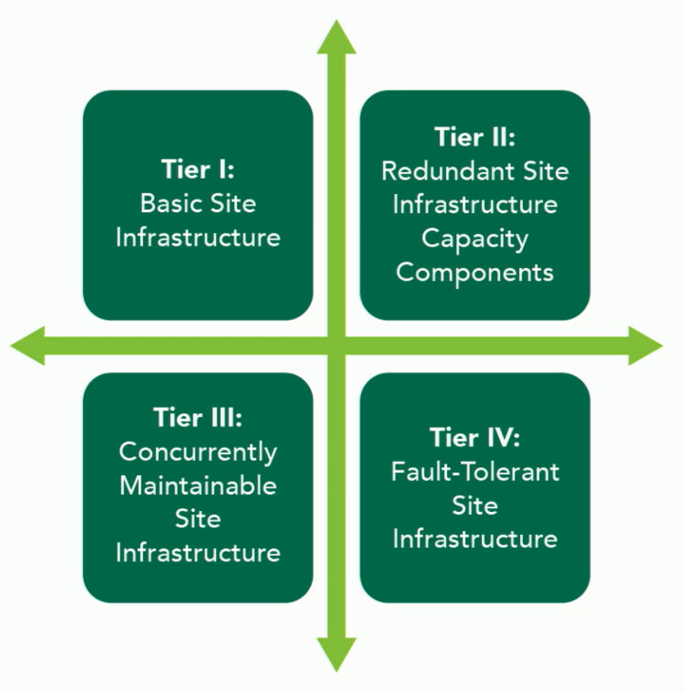
Security Principles of Site/Facility Design
Crime prevention through environmental design
Site planning
Physical availability
Site and facility security controls
Ownership, location, access control, access barriers, organization, emergency procedures…

Slide 12
A Day in the Life of a SOC Analyst
Sonika Verma
CSCD92: Week 10

Slide 13
Day-to-Day Responsibilities
Perform alarm triage overview
Investigate, document, escalate
Perform dashboard review
Environmental security (events, logs, feed stability, systems…)
Review security state data
SIEM system component health review
Identify and report operational issues
Perform active threat hunting
Review security intelligence data
Documentation and carryover

